Slide 1
Medical Devices & Cybersecurity
Nahuel Hernan Ramos
Jennifer Wakstein Masha Zalivansky
Notes:
Hi all! Welcome to our presentation of Medical Devices and Cybersecurity

Slide 2
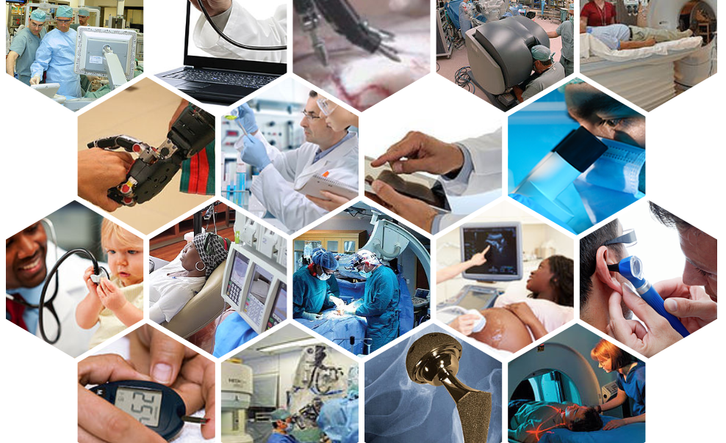
What are Medical Devices?
Notes:
Let’s start by defining what are Medical devices.
The Ex Global Harmonization Task Force, now named The International Medical Device Regulators Forum defines A medical device as is any instrument, apparatus, implement, machine, appliance, implant, in vitro reagent or calibrator, software, and more that is intended for human beings for:
• the diagnosis, prevention, monitoring, treatment or alleviation of disease or injury
• the investigation, replacement, modification, or support of the anatomy or of a physiological process;
• supporting or sustaining life;
• controlling conception;
• disinfecting medical devices; and
• providing information for medical or diagnostic purposes
Today, there are an estimated 2 million different kinds of medical devices on the world market, categorized into more than 7000 generic device groups.
Many of them connected wirelessly to a variety of systems, networks and other tools within a hospital presenting potential points of breach

Slide 3
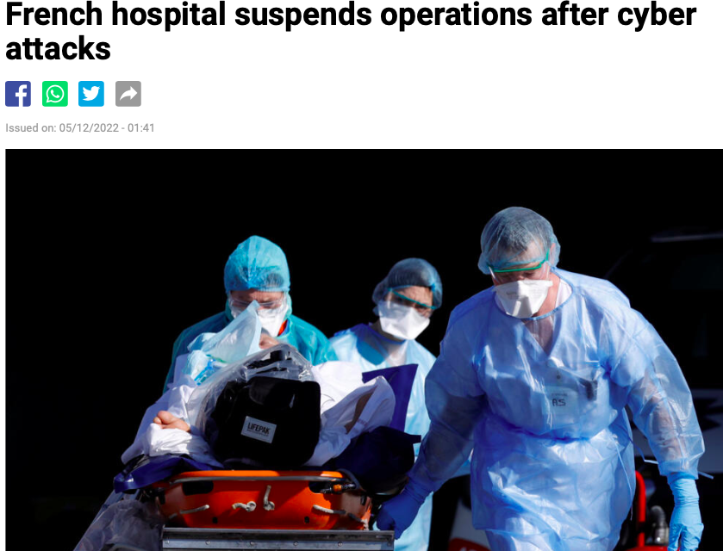
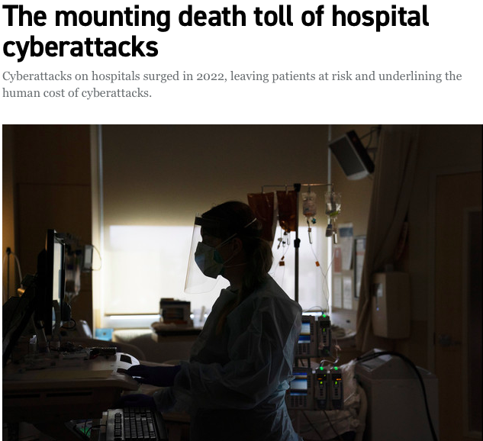
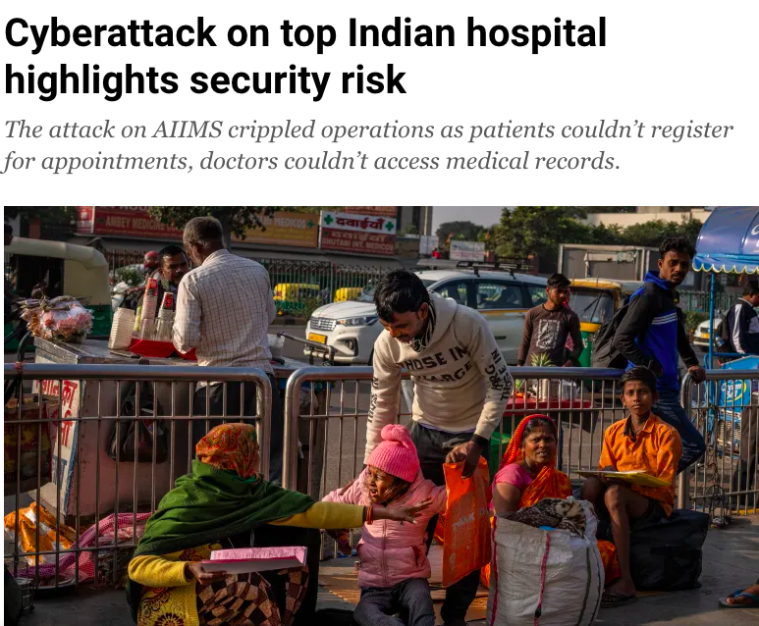
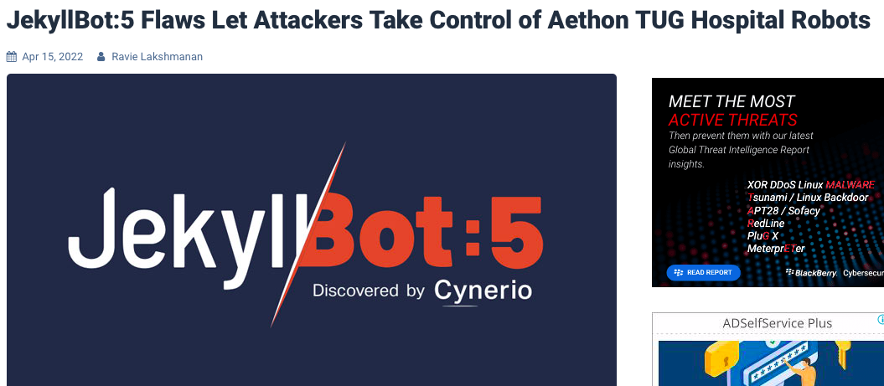
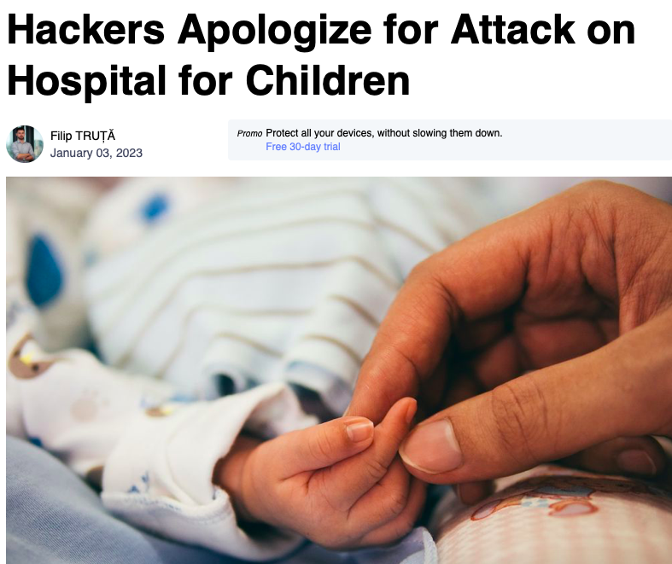
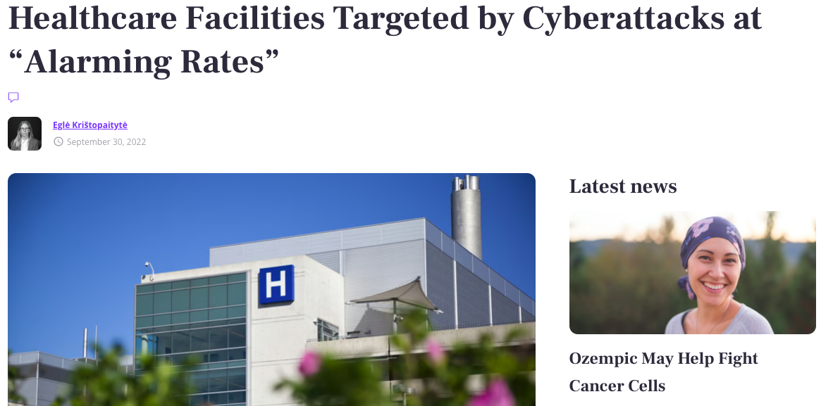
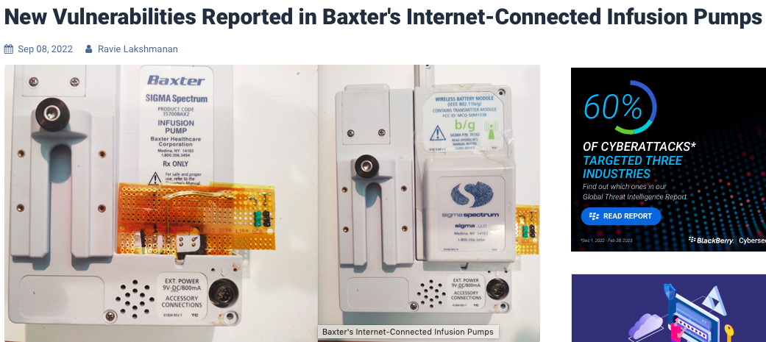
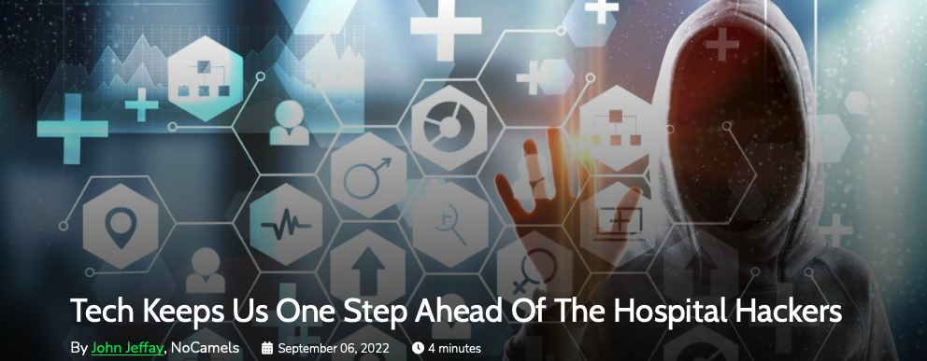
Opening
Notes:
In our research paper we tried to explore the world of medical devices that are used in hospitals, analyze their vulnerabilities and threats, investigate the more recent attacks and figure out the strategies to protect this precious equipment from the attackers.
Healthcare is one of the areas where technological progress has the most impact: we can see better, have artificial organs, monitor babies in utero, live longer and healthier.
And the vulnerabilities in healthcare devices can directly affect our lives.

Slide 4
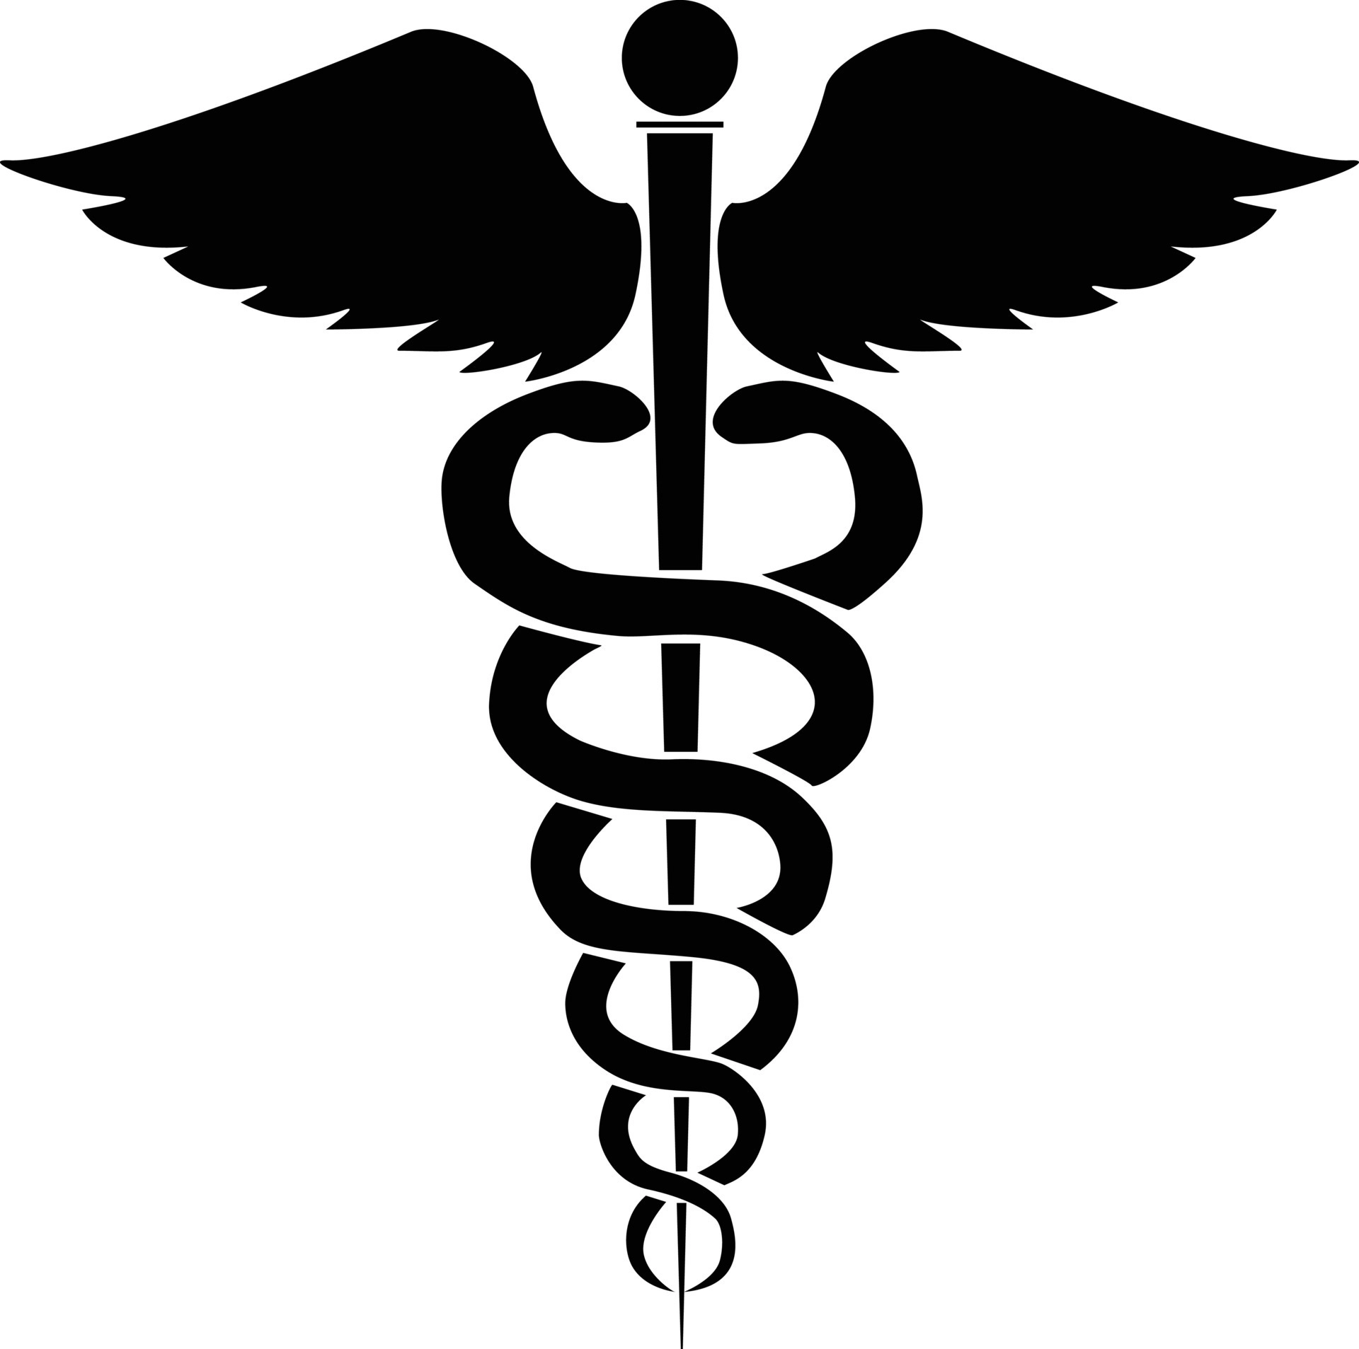
Current cyber situation in the healthcare industry
The healthcare industry is 2 to 3 times more likely to be a target of cybercrime than any other industry
Surge in cyber attacks after the beginning of the pandemic
In 2022 cyberattacks on healthcare services were on the rise
Healthcare institutions are currently the main target for ransomware attacks
Mortality rates increased at a quarter of the healthcare facilities following the attack
Notes:
It’s impossible to talk about the cybersecurity of medical devices without talking about the cybersituation in the healthcare sector in general.
And the situation is dire to say the least. Here are just a few facts and statistics – and we are talking mostly about the US data.
So, first of all, research shows, that the healthcare industry is two to three times more likely to be a target of cybercrime than any other industry.
After the beginning of the pandemic there was a surge in cyber attacks. Healthcare providers saw a 42% increase in data breaches in 2020, and an astounding 69% increase in the volume of cyber attacks from 2020 to 2021 .
For example, phishing attacks against healthcare organizations increased by 220% during the pandemic.
In 2022 cyberattacks on healthcare services were on the rise. The first months of 2022 have witnessed a disproportionate number of cyberattacks against national healthcare systems.
According to the research, healthcare institutions are currently the main target for ransomware attacks. This is the most disruptive type of attack because it leads to the most operational delays.
66% of healthcare organizations say they experienced a ransomware attack in 2021, and that is a horrible increase from 34% in 2020.
By the way in 61% of cases in 2021 healthcare providers decided to pay the ransom.
And lastly, a 2021 study from Proofpoint and the Ponemon Institute shows that after a ransomware attack mortality rates increased at 25% of the facilities.

Slide 5
Cases
First death by ransomware attack
A baby born during the attack on the hospital died 9 months later
Painkillers overdose
A 3-year-old got overdosed on pain medicine during the hospital attack
WannaCry
UK's National Health Service as a major victim
Notes:
These were some general facts, now moving on to actual cases.
With every passing year there are more and more cases of cyberattacks having a real impact on people’s lives.
The first case mentioned here is what the news called “the first death by ransomware attack”. In 2019 a woman in Alabama sued the local hospital for the death of her son. When she was giving birth, the hospital was under a ransomware attack and that prevented doctors from finding out that her son’s umbilical cord was wrapped around his neck in the womb.
The mother claimed that this caused brain damage and 9 months later her son died
2. In another case a 3-year-old boy in Iowa got a dose of painkillers that was five times stronger than what was suitable for his age. Apparently the computer system that automatically calculated medicine doses wasn’t working, and the resident doctor had to make the calculation himself and he got his math the wrong. Later the mother found out that a cyberattack had taken down some of the hospital’s digital tools at the time.
3. And, of course, we all know about the Wannacry disaster. It didn’t specifically target the United Kingdom’s National Health Service, but this global cyber-attack highlighted security vulnerabilities and resulted in the cancellation of thousands of appointments and operations. During the one-week period of the attack 19,000 appointments got canceled.

Slide 6
Why are the healthcare industry and medical devices consistently at risk?
Healthcare information is the most profitable information to sell on the black market
Medical devices are an easy way for attackers to gain entry
They are not made with security in mind
Medical devices are most commonly run on Linux-based medical software
They stay in operation despite being outdated
Notes:
Now you are maybe wondering why the healthcare industry and medical devices are consistently at risk? I will tell you why.
First of all, healthcare information is the most profitable information to sell on the black market. And most attackers don’t think about patients or other people that will suffer when they see an opportunity.
Medical devices that are on a network represent an easy way for attackers to gain entry because they weren’t designed with security in mind. And so they can be used to launch attacks on servers that store the data.
Medical professionals work too much and their primary goal is to save lives, so they usually don’t think too much about online security. Lack of proper authentication measures for devices and lack of time to ensure security are real issues in this sector.
Medical devices are most commonly run on Linux-based medical software that can’t be protected by traditional cybersecurity like Windows-based software.
They stay in operation despite being outdated, and that can create vulnerabilities for the attackers to exploit.
Some of the most vulnerable devices for a cyberattack are IV pumps, ultrasounds and cardiac monitoring systems.
It is important to note that even if medical devices are not the prime target for the cybercriminals they are a part of the medical institution’s network and so they are also highly susceptible to the attacks.
And speaking of the attacks – now it’s Nahuel’s turn with attacks and mitigations

Slide 7
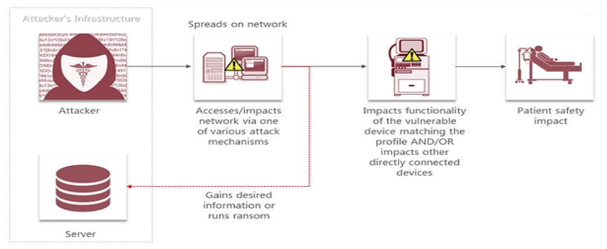
Attacks
Notes:
How does an attack on medical devices look like?
It starts when an attacker gets access to a network with various mechanisms as phishing, insertion of infected USB, firmware updates, firmware updates via wifi, packet sniffing, among others.
One time the attacker gets access it can gain desired information or run ransomware and impact all medicine devices connected to this network and consequently to the health of the patient.
He can get medical records as passwords, health condition, social security number, payment details, purchase histories, physical location, home address, photos and videos, marital status and gender.

Slide 8
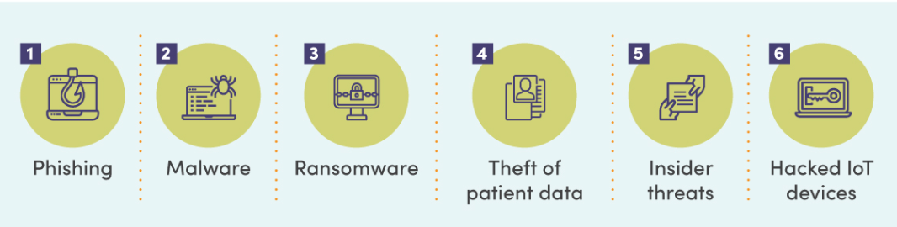
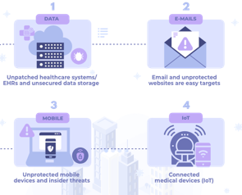
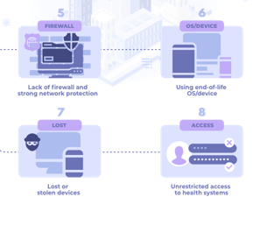
Attacks
EHR Servers
Workstations
Monitors
Central Station Monitoring
Pumps
Ventilators
Body heater
Communication box
Notes:
The attacks more importance again medical devices are: phishing, malware, ransomware, theft of patient data, insider threats and hacked IoT devices.
We can find vulnerabilities in the devices where the attacker can exploit to stole data:
-Unpatched healthcare systems/EHRs and unsecured data storage. It allow the attack to inject or install malicious software.
-Email and unprotected websites. The employee or patient can open it.
-Unprotected mobile devices and insider threats. It allow attacks as update firmware via wifi or a someone connect a malicious USB in some devices.
-Connected medical devices (IoT). Patients and employeet can allow access at attacks thought of her/him personal devices.
-Lack of firewall and strong network protection.
-Using end-of-life OS/device.
-Lost or stolen devices.
-Unrestricted access to health systems.
There is medical devices as servers, Central Station Monitoring, pumps, ventilators, monitors, workstations and communication box.

Slide 9
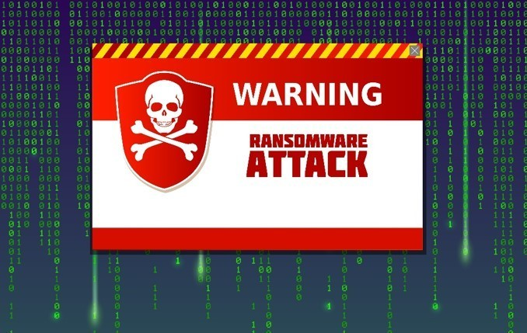
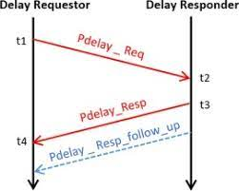


Mitigations
Strong passwords/MFA
Session ID with trusted sources
VPN
Update Software
User Training
Encryption
Network Segmentation
Remote Data Storage
Restrict File and Directory Permissions
User Training
AV/Antimalware
IDS
Restrict Web-Based Content
Software Configuration
User Training
Notes:
Ransomware and delay attack:
Antivirus/Antimalware:
Anti-virus can also automatically quarantine suspicious files.
Network Intrusion Prevention:
Network intrusion prevention systems and systems designed to scan and remove malicious email attachments can be used to block activity.
Restrict Web-Based Content:
Block unknown or unused attachments by default that should not be transmitted over email as a best practice to prevent some vectors, such as .scr, .exe, .pif, .cpl, etc.
Software Configuration:
Use anti-spoofing and email authentication mechanisms to filter messages based on validity checks of the sender domain (using SPF) and integrity of messages (using DKIM). Enabling these mechanisms within an organization (through policies such as DMARC) may enable recipients (intra-org and cross domain) to perform similar message filtering and validation.
User Training:
Users can be trained to identify social engineering techniques and spear phishing emails.
Session Hijacking
Use strong passwords and multifactor authentication: These techniques protect accounts from being accessed by hackers if they manage to steal a user’s session ID.
Only share session IDs with trusted sources:Be careful when sharing links or sending requests to websites, as these may include session IDs.
Use a VPN: A VPN helps prevent attackers from intercepting traffic, making it more difficult for them to steal session IDs.
Keep software up to date:Make sure to keep operating systems and software up to date with the latest security patches to prevent attackers from exploiting vulnerabilities to access users’ sessions.
Take cybersecurity training: Cybersecurity threats are constantly evolving, so it’s essential to stay informed on the latest attack techniques and how to prevent them. Consider getting certified in various cybersecurity domains, including ethical hacking, incident handling, and penetration testing.
Data manipulation and Configuration Manipulation
Encrypt Sensitive Information:
Encrypting important information to reduce an adversary’s ability to perform tailored data modifications.
Network Segmentation:
Identify critical business and system processes that may be targeted by adversaries and work to isolate and secure those systems against unauthorized access and tampering.
Remote Data Storage:
Consider implementing IT disaster recovery plans that contain procedures for taking regular data backups that can be used to restore organizational data. Ensure backups are stored off system and are protected from common methods adversaries may use to gain access and manipulate backups.
Restrict File and Directory Permissions:
Ensure least privilege principles are applied to important information resources to reduce exposure to data manipulation risk.

Slide 10
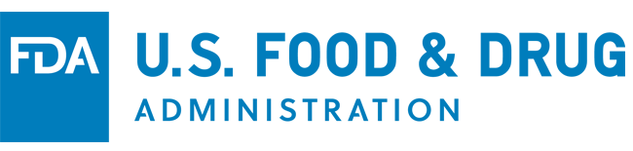
New suggested solutions:
New regulations concerning cybersecurity
Submit a plan on how to "monitor, identify, and address" cybersecurity issues
Need to make security updates and patches available on a regular schedule and in critical situations
Provide the FDA with "a software bill of materials
Notes:
For new suggested solutions we have first something that is new but is already a fact!
The new regulations concerning cybersecurity by the FDA.
First, let me introduce the FDA (US Food and Drug Administration) that is in charge of regulating medical devices, among other products like foods and drugs of course hehe, also biologics, veterinary, cosmetic and other products.
Recently, in december 2022, "Ensuring Cybersecurity of Medical Devices" amended the Federal Food, Drug, and Cosmetic Act and was signed as LAW.
As part of the new law, all new medical device applicants must now submit a plan on how to "monitor, identify, and address" cybersecurity issues
They need to be ready to make security updates and patches regularly and mostly in critical situations
And should provide the FDS with a “software bill of materials”
What is a bill of materials? is an inventory detailing all the items included in a product, when we talk about Software bill of materials, is a list of all the open source and third-party components present in a codebase and also lists the licenses that govern those components, the versions of the components used in the codebase, and their patch status, which allows security teams to quickly identify any associated security or license risks.

Slide 11
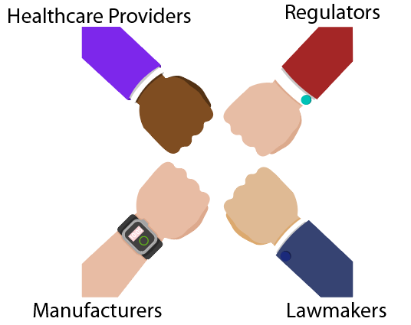
New suggested solutions:
Coordinated cooperation
Notes:
Coordinated cooperation
Nowadays hospitals have the main responsibility of safeguarding the confidentiality of patient data, data integrity and availability and functionality of the devices itself.
Manufacturers must share with health systems this responsibility
Regulators should also consider revisiting the landscape for security breach penalties proportionally applied to the product manufacturer and the health system experiencing the breach based on their relative contribution to the breach’s root cause

Slide 12

New suggested solutions:
Incorporating cybersecurity in academic programs
Incorporate Cybersecurity courses to curriculum
Establish Cybersecurity certificates for minors
Encourage research in cybersecurity
Promote cybersecurity awareness and safety
Notes:
In EDUCATION
Add cybersecurity courses to the curriculum to the Universities and colleges existing computer science, engineering, or business programs. Including hands-on labs and practical exercises to give students real-world experience in addressing cybersecurity challenges.
Establish cybersecurity certificates or minors: For those that are not very familiar with the system: Majors and minors allow you to customize your bachelor's degree based on what you would like to specialize in. Simply put: a major is your main specialization and a minor is your secondary specialization.
These programs can be designed to provide students with a broad understanding of cybersecurity concepts, as well as specialized knowledge in specific areas of cybersecurity.
Encourage research in cybersecurity: Universities can encourage students to pursue cybersecurity research through student projects, capstone courses, or internships. This can help students to develop critical thinking and problem-solving skills and contribute to the advancement of cybersecurity knowledge.
Promote cybersecurity awareness and safety: promote cybersecurity awareness and safety by providing training to students, faculty, and staff on how to protect their digital assets and personal information, risks of social engineering, phishing, and other cyber threats, and providing guidance on how to create strong passwords and secure their devices.

Slide 13
Conclusion
Prioritize cybersecurity measures in medical devices and healthcare systems to ensure patient safety and confidentiality.
⬆️Awareness
⬆️Education
✋Enforce
🤝Collaboration
Notes:
So,
Medical devices are often at a great risk of being compromised, if not as direct attack, but as a collateral damage from a big-scale attack on a hospital or a healthcare facility.
It is critical to prioritize cybersecurity measures in medical devices and healthcare systems to ensure patient safety and confidentiality.
This can be achieved by increase awareness, education, increase and enforce regulations in the whole manufacturing process and life cycle of the medical devices, and with collaboration among healthcare providers, manufacturers, regulators, and cybersecurity experts.

Slide 14
Deliverable #1
Interview

Slide 15
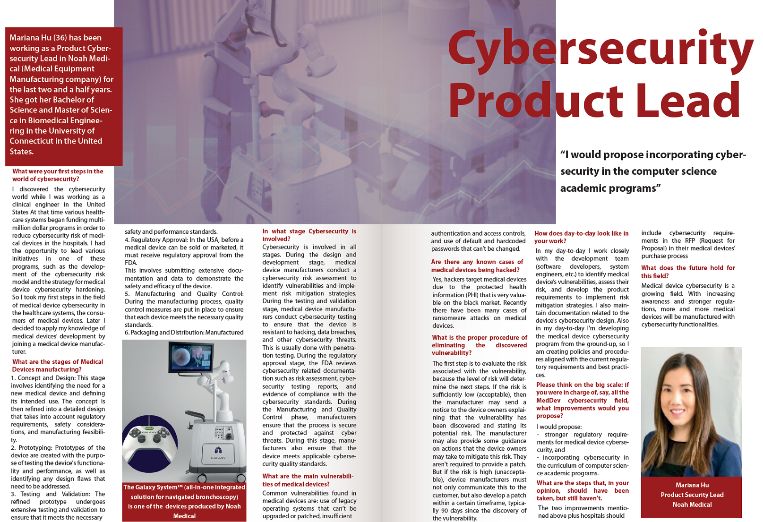
Notes:
As the first deliverable we have here the interview with a friend of Jenny – and Jenny has many great friends – Mariana Hu.
Mariana is a Product Cybersecurity Lead in Noah Medical, which is an american Medical Equipment Manufacturing company.
We were lucky to get to interview her and ask her about her job, about the stages of medical devices’ manufacturing process, about the main vulnerabilities and so on. You will be able to read the whole thing later, but now here a few bits and pieces.

Slide 16
What are the stages of Medical Devices manufacturing?
1. Concept and Design
2. Prototyping
3. Testing and Validation
4. Regulatory Approval
5. Manufacturing and Quality Control
6. Packaging and Distribution
Notes:
For example Mariana explained to us how the manufacturing process of a medical device looks like.
First stage is Concept and Design
Second stage is Prototyping
Third stage is Testing and Validation
The refined prototype undergoes extensive testing and validation to ensure that it meets the necessary safety and performance standards.
Stage number 4 is Regulatory Approval
In the USA, before a medical device can be sold or marketed, it must receive approval from the FDA. This involves submitting huuuuge amount of documentation and data to demonstrate the safety and efficacy of the device. And as Jenny mentioned earlier, now it also includes cybersecurity.
Stage 5 is Manufacturing and Quality Control
The last stage is of course Packaging and Distribution
Manufactured devices are packaged and prepared for distribution.

Slide 17
What are the main vulnerabilities of medical devices?
Use of legacy operating systems
Insufficient authentication and access controls
Use of default and hardcoded passwords
Notes:
We also asked Mariana about the main vulnerabilities that can be found in medical devices. She mentioned the following:
use of legacy operating systems that can’t be upgraded or patched
insufficient authentication and access controls, and
use of default and hardcoded passwords that can’t be changed

Slide 18
Eliminating the discovered vulnerability
Evaluate the risk
Acceptable risk
Unacceptable risk
Send a notice to the device owners
Send a notice AND develop a patch within a certain timeframe
Notes:
And, finally, the most interesting point, at least for me, was the actions of the manufacturer when he discovers a vulnerability in one of his devices.
When the vulnerability is discovered the first step is to evaluate the risk associated with it, because the level of risk will determine the next steps. If the risk is sufficiently low (acceptable), then the manufacturer may send a notice to the device owners explaining that the vulnerability has been discovered and stating its potential risk. The manufacturer may also provide some guidance on actions that the device owners may take to mitigate this risk. He is not required to provide a patch. But if the risk is high (unacceptable), device manufacturers must not only communicate this to the customer, but also develop a patch within a certain timeframe, typically 90 days since the discovery of the vulnerability.

Slide 19
Deliverable #2
Poster

Slide 20
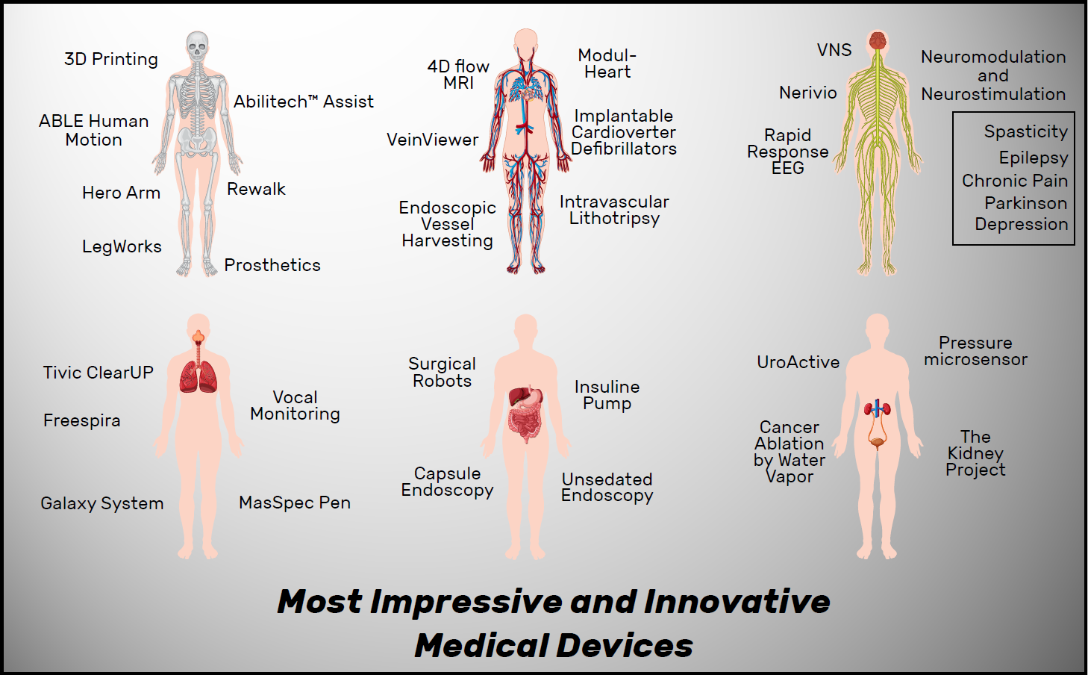
Notes:
As second deliverable we made a Poster with devices that we considered innovative and impressive.
The devices are separated in relation to the body system in which they work.
Here are our highlights:
Some of this devices makes life normal for some people:
UroActive is an active implantable electronic artificial urinary sphincter.
The Insuline Pump, so diabetics don’t have to inject themselves several times a day, this device delivers the insulin during the day.

Slide 21
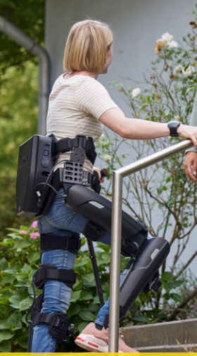
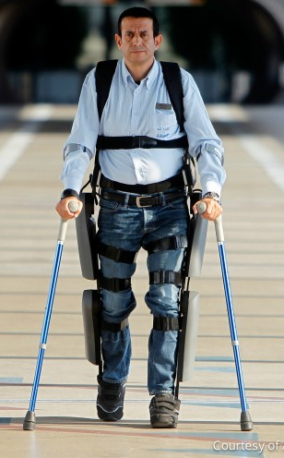
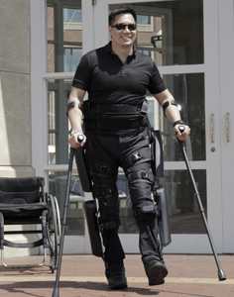
Notes:
ReWalk is a wearable robotic exoskeleton that provides powered hip and knee motion to enable individuals with spinal cord injury (SCI) to stand upright, walk, turn, and climb and descend stairs. It was developed by an Israeli company

Slide 22
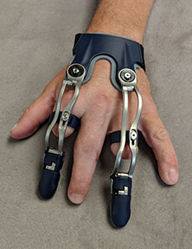
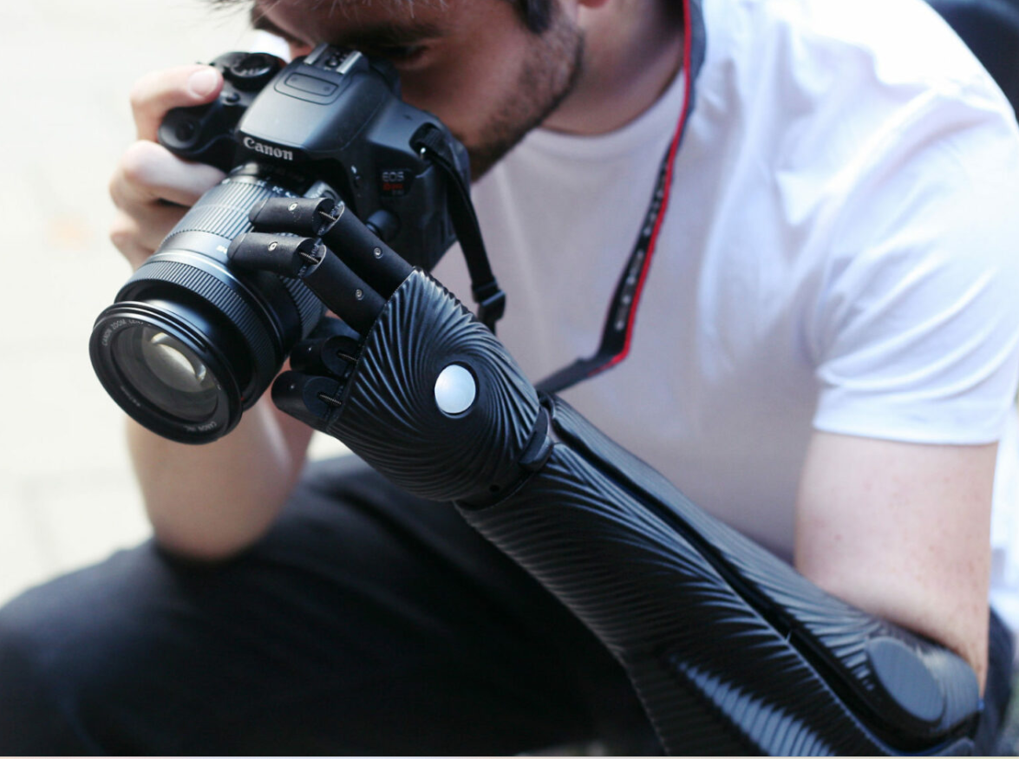
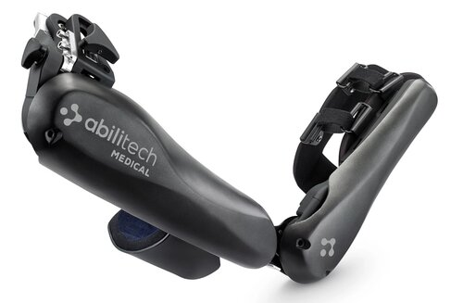
Notes:
The development in prosthetics is impressive improving lives and fomenting independence

Slide 23
Notes:
Neuromodulation and Neurostimulation offer new hope for individuals with neurological disorders and regulate and normalize the activity of the nervous system
This techniques has application in Pain Managment, Addressing Movement Disorders and Enhancing Mental Health.
A great example of this is Nerivio, a drug-free, wearable device for migraine treatment and prevention
VNS, is a type of neuromodulation to treat seizures that don’t respond to medication.

Slide 24
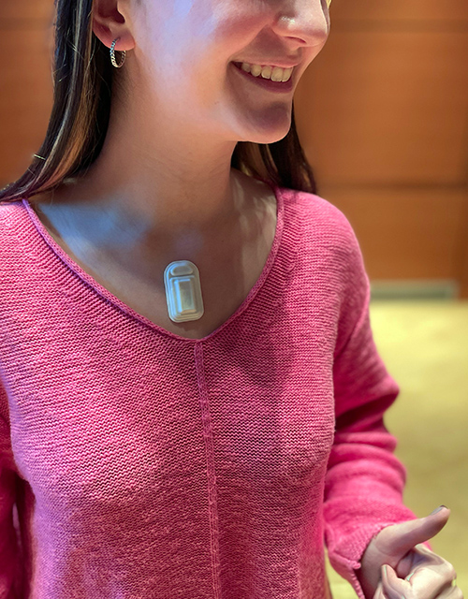
Notes:
The First wearable device for vocal fatigue senses when your voice needs a break.
For the people who make their livings by speaking or singing, vocal fatigue is a constant, looming threat. This occurs when overused vocal folds swell, making the voice sound raspy.
To use the device, the wearer simply adheres it to the sternum, below the neck, and syncs the device with the accompanying app.

Slide 25
Notes:
The field of cardiovascular healthcare has witnessed remarkable progress in recent years, thanks to relentless research and innovative technologies.
For example, sound waves, that used to be to treat kidney stones, now was retarget towards calcified artery blockages.
Researchers have developed a new technology to diagnose patients with heart failure in record time. Using MRI to create detailed 4D images of the heart. While standard MRI scan can take up to 20 minutes or more, this new technique takes just eight minutes.

Slide 26
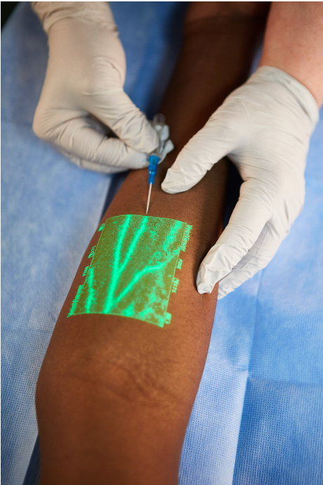
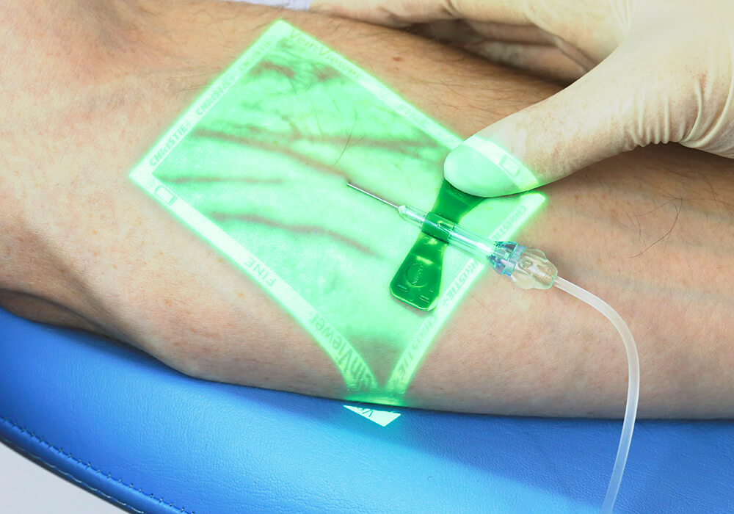
Notes:
Veinviewer is a vein visualization product designed to provide clinicians with an accurate image of patient superficial veins and reduce the time needed to start a peripheral IV.
It’s mostly helpful for diabetics, cancer patients and dehydrated ones. And KIDS!

Slide 27
Notes:
In the field of Surgery
MasSpec Pen combines mass spectrometry, and artificial intelligence to have a precise identification of tissue.
In the Conventional Way: the tissue is biopsied, sent to the laboratory, frozen, sliced, stained, and examined by a pathologist under a microscope. This process takes around 40 minutes and happens while the patient is under anesthesia.
With this device, In under 10 seconds, the surgeon receives a reading of either “cancerous” or “normal” tissue

Slide 28
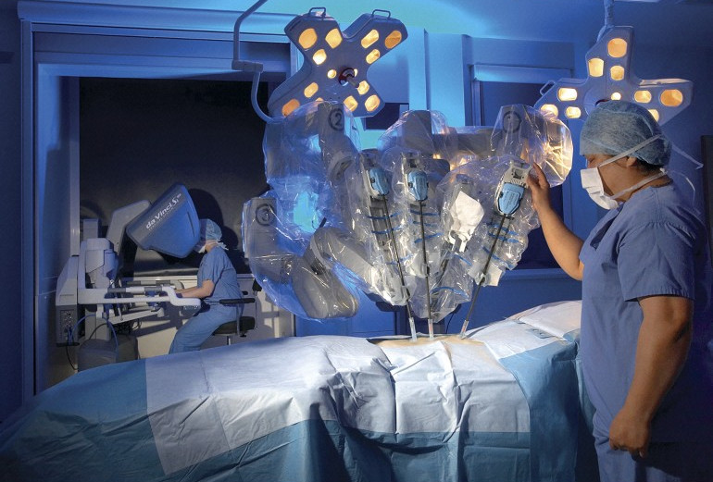
Notes:
Lastly, also related to surgery
we have the surgical robots, da Vinci was the first one, and now, after two decades of leading the market, the patents are expiring opening the robotic surgery market up to a new school of competitors, so we will hear about this a lot in the future.

Slide 29
Thank you for your attention!

